Slide 1
Analysis of Cuisines and Restaurants
Team: Asmita, Deena

Slide 2
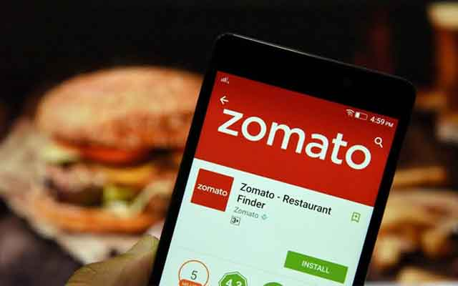
Overview of data
Analysis uses Zomato data that contains restaurant information for 15 countries.
Restaurant information includes:
Location
Ratings - Overall and Price
Cuisines available
Average cost for two
Additional services offered like table booking, delivery etc.

Slide 3
Objectives
Enable users to search for a city and get information regarding restaurants in that city. Great for food lovers cum travellers!
Give insight into how cuisines have globalized by looking at popular non-local cuisine in different countries.
Look at restaurant data available on Zomato for US.

Slide 4
Dashboard Website
https://asmitav.github.io/

